Slide 1
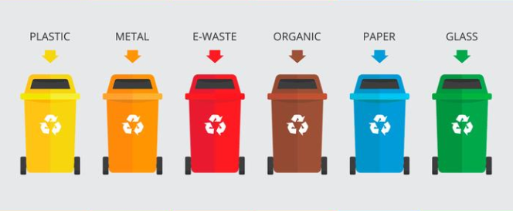
Automate Garbage Classification Improving Waste Management using Machine Learning
Kevin Hoang, Reeva Lohia, Rita Tu
Notes:
Rita

Slide 2
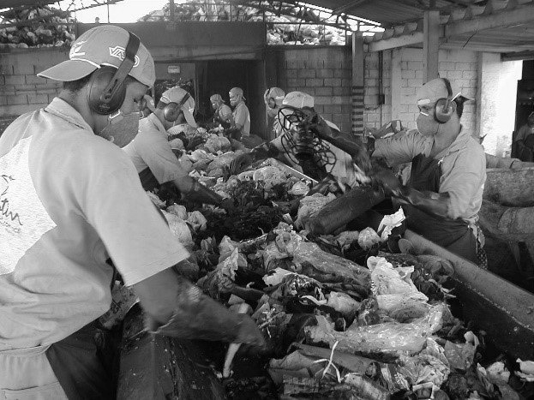
Objective
Garbage classification is a critical step in waste management
It can be challenging due to
Lack of knowledge
Confusion about recycling symbols
Language and cultural barriers
Inconsistent regulations
Lack of infrastructure
Improving waste management practices can lead to environmental, economic, and social benefits
Notes:
Rita

Slide 3
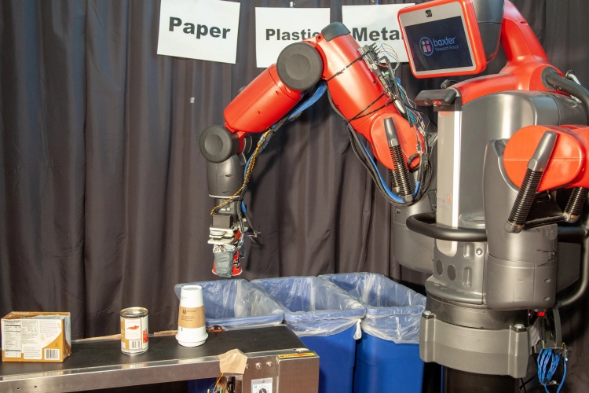
Role of Machine Learning
Automate garbage classification to improve accuracy and increase efficiency
Address challenges related to inconsistent regulations and social barriers by providing a standardized approach to garbage classification
Optimize waste management infrastructure by identifying areas where additional facilities are needed
Provide insights into waste generation patterns and disposal practices
Notes:
Rita

Slide 4

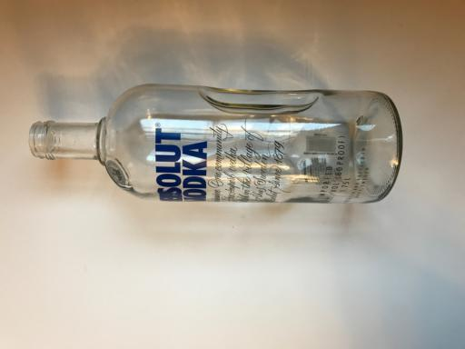
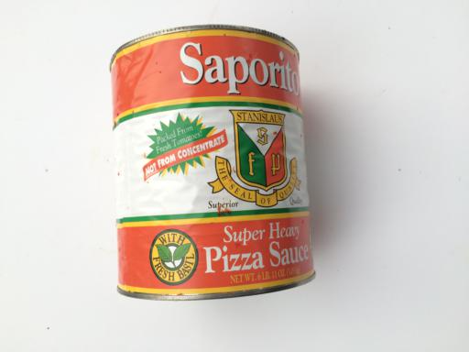
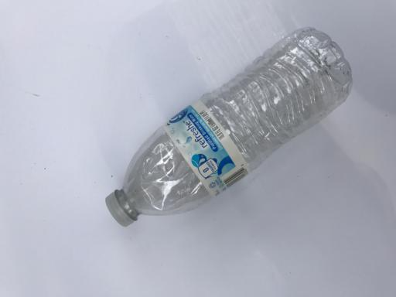
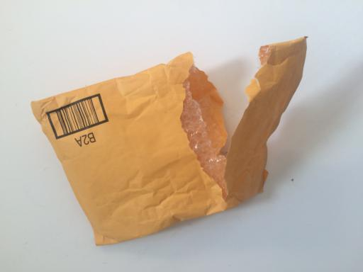
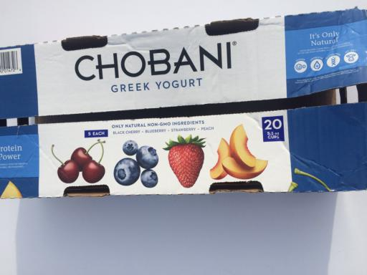
CARDBOARD
GLASS
METAL
PAPER
PLASTIC
TRASH
Notes:
Rita

Slide 5
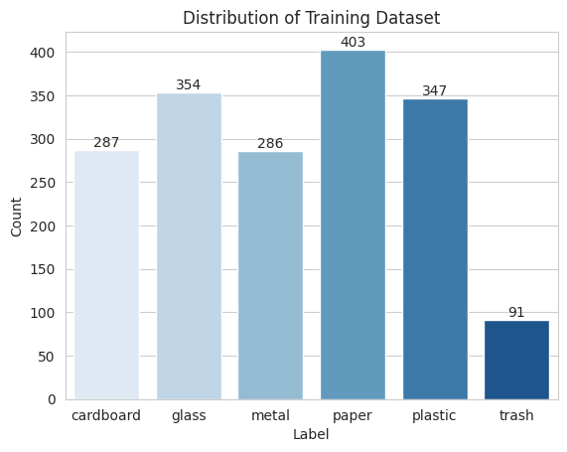
Dataset
Kaggle Dataset published in 2018
Source not known
2500+ Images available in JPG format
Predefined Train-Validation-Test Split
1,768 training examples
328 validation examples
431 test examples
Imbalanced dataset
Notes:
Rita

Slide 6
Baseline
Two simple ways to estimate baseline
Guess 1 label out of 6 randomly
Always guess the majority class (Paper)
18%
Random Guessing
25%
Majority Class
Notes:
Rita

Slide 7
Traditional ML
21.65%
34.75%
Logistic Regression
K-Means with 6 clusters
Random Forest
K-Nearest neighbors (20 neighbors)
66.77%
37.50%
Notes:
Rita

Slide 8
Traditional ML
21.65%
34.75%
Logistic Regression
K-Means with 6 clusters
Random Forest
K-Nearest neighbors (20 neighbors)
66.77%
37.50%
Notes:
Rita

Slide 9
Deep Learning using CNN
Notes:
Kevin (0:11.16)
Next, we explore the effectiveness of deep learning models, namely convolutional neural networks, to hopefully beat the 67% benchmark of random forest.

Slide 10
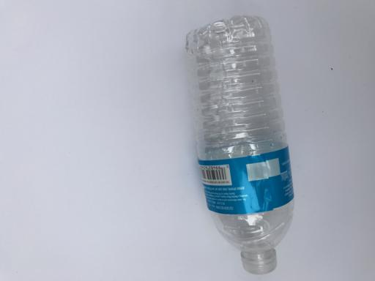
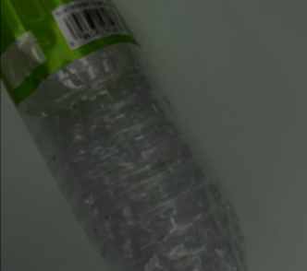
Data Augmentation
Keras ImageDataGenerator Class: Applies the following augmentations randomly upon each training image during each epoch of training
Rotations up to 30 degrees
Horizontal and vertical shifts up to 10% of the image size - nearest pixel occupies former pixels
Shearing with a maximum shear of 0.2 radians/~11 degrees
Zooming up to 20%
Horizontal and/or vertical flips
(Experimental) Brightness of image from 20% to 80%
(Experimental) Hue coordinate of the image in HSV coordinates, up to a value of 128
Notes:
Kevin (1:22.76)
Initially, we acknowledged the relatively small size of our training dataset at about 1,700 images. We employed data augmentation with Keras’s ImageDataGenerator class, which applies augmentations randomly, upon each training image, during each epoch of training. Consequently, this results in about 1,700 times the number of epochs of augmented images total passed through the training stage. The augmentations we randomly apply are as follows.
Rotations of up to 30 degrees.
Horizontal and vertical shifts of up to 10% of the image size, former pixels being filled in via the nearest pixel.
Shearing, which fixes an axis and stretches the image along the other axis at an angle of up to 0.2 radians, or roughly 11 degrees.
Zooming of up to a 20% zoom level.
Horizontal and/or vertical flips.
And two experimental augmentations, which we try out in hopes to have our model be resistant to variations in color:
Brightness from 20 to 80 percent.
And shifting the image’s hue coordinate in HSV coordinates by up to 128.

Slide 11
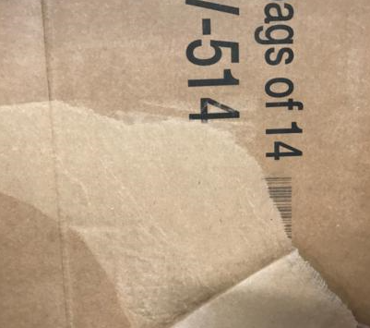
Modeling Process
224 x 224
Architecture | Augmentations | Validation Accuracies | Hyperparameters
Choice 1: Simple Neural Net - 1 hidden layer - Softmax layer | None | 24.38% | All: - 30 epochs - Adam optimizer - 0.01 learning rate - ReLU activation - Early stopping with a patience of 3 epochs for validation loss
Choice 2: Convolutional Neural Net - 3 convolution and max pooling layers - 1 hidden layer - Softmax layer | Rescale, rotation, shift, shear, zoom, flip | 64.33% (Shape/Position Augmentations)
 | Above + random brightness and hue shift | 42.07% (+Brightness/Color Augmentations)
Softmax
Hidden Layer
Conv2D
Max Pooling
128
# Filters:
64
128
224 x 224
32
128
Notes:
Kevin (1:49:56)
Onto the specific neural network models we trained, we started with a very simple neural net without augmentations - single hidden layer of size 128 plus the softmax layer - seing if a simple model would yield a good validation accuracy compared to our random forest benchmark. It didn’t - with an accuracy of 24.38%.
Our next choice was a convolutional neural net, which we chose to add position and scale invariance to our model considering the different sizes and positions of objects in our images. Here, we add 3 convolution layers of 32, 64, and 128 filters successively, each followed by 2-by-2 max pooling layers. The increasing number of filters is intended to have our neural net learn simpler image features with the initial layers, and more complex, subtle features with subsequent layers. We stack a hidden layer of size 128 at the end with the softmax. This model architecture we ran with two sets of augmentations, the first having the shape and position augmentations and the second adding brightness and hue shift onto the shape augmentations. Interestingly, the first set of augmentations yielded a better validation accuracy at 64% versus 42% with the second set. The color augmentations perhaps over-manipulated the training images in such a way that the CNN couldn’t learn meaningful features for accurate classification.
We experimented intensively with tuning hyperparameters across the models. We won’t list every single combination here as none had much higher accuracy than in the choices we depict here. We stuck with 30 epochs, Adam optimizer, 0.01 learning rate, ReLU activation, and early stopping, at no improvement in validation loss after 3 epochs.

Slide 12
Modeling Process (cont.)
Architecture | Augmentations | Hyperparameters
Top Choice: Convolutional Neural Net - 4 convolution and max pooling layers - 2 hidden layers - 2 dropout layers - Softmax layer | Rescale, rotation, shift, shear, zoom, flip | - 30 epochs - Adam optimizer - 0.001 learning rate - ReLU activation - Early stopping with patience of 3 epochs for validation loss
# Filters:
256
64
128
224 x 224
32
128
.2
128
.2
Softmax
Hidden Layer
Dropout Layer
Validation Accuracy:
67.81%
Conv2D
Max Pooling
Notes:
Kevin (0:38.30)
In an attempt to bump the validation accuracy further, we experimented with a model including another convolution layer of 256 filters accompanied by a 2-by-2 max pooling layer, another hidden layer of size 128, and two dropout layers with a rate of 0.2 following the hidden layers. We stuck with only using the position and size augmentations with the better accuracy, and the only hyperparameter we changed from the first two choices was setting the learning rate to be 0.001 to prevent wildly oscillating losses. There was slight success here, with a bump to a 67.81% validation accuracy.

Slide 13
Findings
Top choice CNN had validation accuracy comparable to random forest, but invoking much more computational time
We considered heuristic methods such as one vs. all and one vs. one, not to much success
One vs. All: Class imbalance, difficulty learning true positives
One vs. One: Needing to train 15 different binary classifiers
Complexities in the data and labels (e.g. paper placed on glass bottles or metal cans) → Lack of data our biggest challenge for producing CNN from scratch
Key Modeling Decision: Shift to using a pre-trained model
Notes:
Kevin (1:45.29)
At this point, we stepped back and put out an honest evaluation of our deep learning approach.
Our first finding was that our top choice CNN so far had validation accuracy just slightly edging out our random forest benchmark: 68 versus 67 percent. But our top choice CNN took about 15 minutes to train on the fastest device our group had, compared to mere seconds of training random forest on weaker devices.
As multiclass image classification is also more difficult than binary classification, we considered heuristic methods such as one vs. all and one vs. one for deep learning, but not to much success.
The one vs. all approach involves training separate binary classifiers upon each image class. However, this would lead to a class imbalance in trying to learn true positives. Our initial attempts at this would lead to binary classifiers producing negative predictions for all images at about 80% validation accuracy per class (90 with the underrepresented trash category).
On the other hand, the one vs. one approach involves training separate binary classifiers for each pair of classes. However, this means that we’d need to train 15 different binary classifiers as there are 15 pairs of classes. This would invoke excessive computational time and power.
Third, there are complexities in our images, such as paper labels being placed on glass bottles or metal cans. We would need a way larger pool of data than 1,700 images in order for our deep learning model to accurately pick up on these nuances.
Hence, we decided that lack of data was our biggest obstacle in building highly accurate deep learning models from scratch, and we made a large shift in direction to explore using a pre-trained model.

Slide 14
Transfer Learning using ResNet
Notes:
Reeva

Slide 15
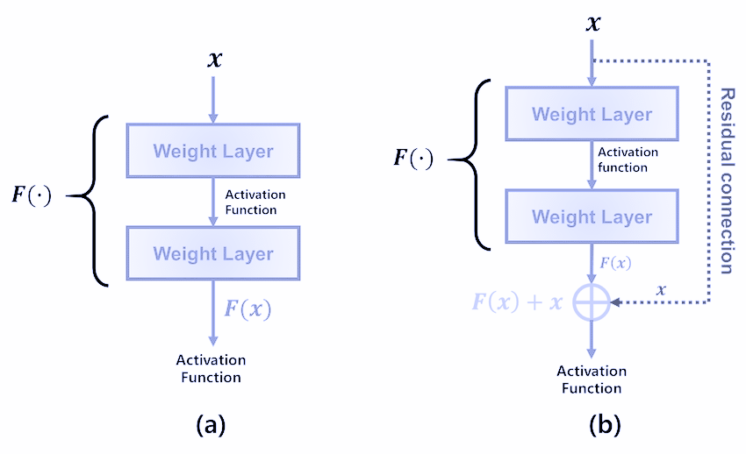
ResNet50
Deep CNN architecture developed by Microsoft
Pretrained on the ImageNet dataset
Part of the ResNet family of models known for their deep residual connections
50 layers with a combination of convolutional, pooling, and fully connected layers
The middle layers of ResNet50 consist of residual blocks, which contain multiple convolutional layers and shortcut connections that bypass one or more layers
Residual connections allow for gradients to propagate more easily through the network, making it easier to train very deep models
Notes:
Reeva

Slide 16
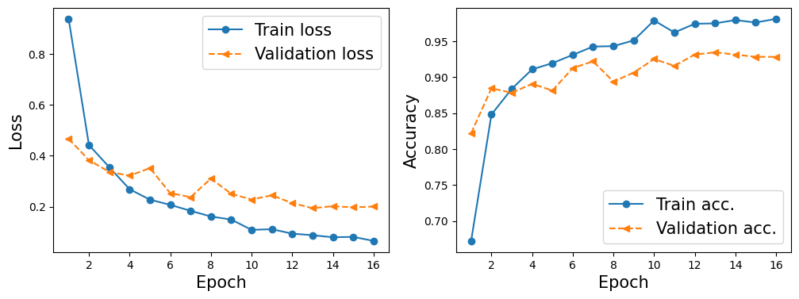
Model Architecture
Used ResNet50 as the base architecture
ResNet50 layers were frozen to prevent overfitting
3 additional layers:
Global average pooling layer to reduce number of parameters and extract features
A fully connected layer with ReLU activation
Output layer with softmax activation function
Adam optimizer with a small learning rate of 1e-4
Used class weights to handle class imbalance
Experimented with techniques like Early stopping & Learning Rate scheduler
Notes:
Reeva

Slide 17
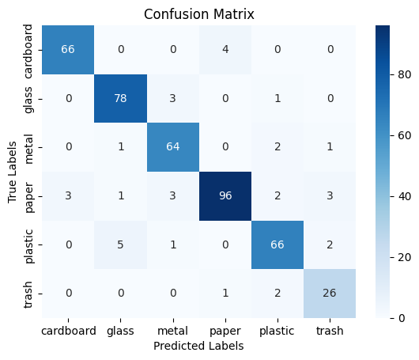
Model Performance
Test Accuracy : 91.88%
 | Precision | Recall
Cardboard | 0.96 | 0.94
Glass | 0.92 | 0.95
Metal | 0.90 | 0.94
Paper | 0.95 | 0.89
Plastic | 0.90 | 0.89
Trash | 0.81 | 0.90
Notes:
Reeva

Slide 18
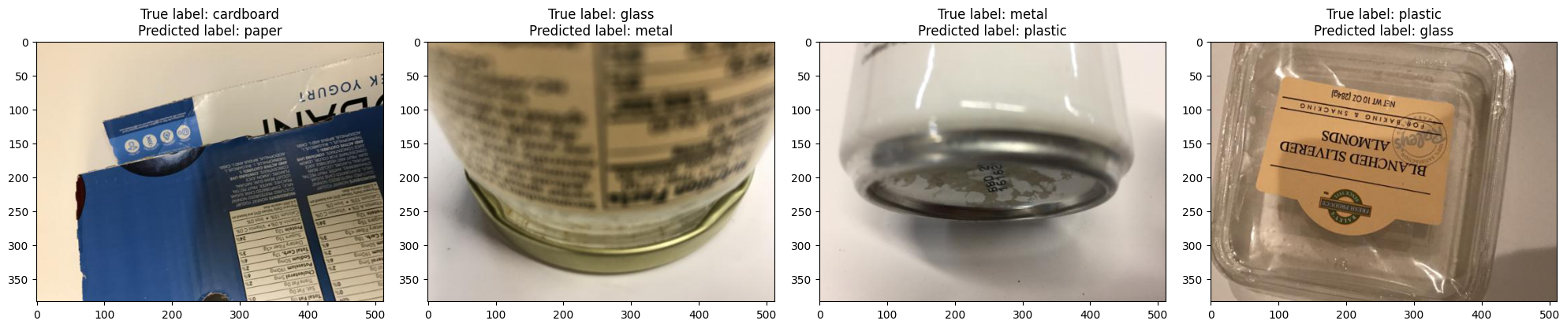
Challenges
Class imbalance: Number of images in each class is not balanced
Inconsistent image quality: Images have varying image quality, lighting, and backgrounds
Limited representation of garbage: Does not seem like representative sample of all possible types of garbage eg. most images in Glass class are either a bottle or jar
Label noise : The labeling process is not known making it difficult to comment on label quality
Data collection bias: The source of the dataset is not clear. Dataset from one location may not be representative of garbage items in other regions
Notes:
Reeva

Slide 19
Future Work
Increase the training dataset size
Address class imbalance by collecting more images for minority classes
Collect data from multiple regions and cultures
Improve the image quality of the dataset
Compare other pre-trained models : VGG, DenseNet, Efficient Net
Notes:
Reeva

Slide 20
Thanks!
Questions?

